Slide 1
AI FUNDAMENTALS
Madison College
Week 04
Large Language Models (LLMs) – Part 2, Applying LLMs
Notes:
PART 1:
In Part 1 of the lecture on Large Language Models, I covered the fundamental concepts behind an LLM. I discussed their architecture, the training processes involved, the diverse data requirements, and the significant computational resources necessary for their development and deployment.
PART 2:
Now we will shift the focus from theoretical aspects to practical application. Specifically, we will show how to interact with and utilize these powerful models effectively. From understanding the importance of crafting effective prompts, to the basics of creating prompts, and some advanced techniques for using them.

Slide 2

TOPICS
Importance of Effective Prompts
Basics of Creating Prompts
Writing Clear & Concise Prompts
Advanced Techniques
Demonstrations
Ethical Considerations
Notes:
Crafting the right prompt directly affects the quality of responses from a Large Language Model. I will cover the basics of creating prompts. Including understanding their structure and how to form them correctly to get the desired output. I will show techniques for writing clear and concise prompts that lead to more accurate and relevant responses.
I will also show methods for handling complex tasks and guiding the model to produce more detailed responses.
The effectiveness of your interactions with an LLM depends on how you structure your prompts. The clarity and specificity of your prompt guide the model in generating accurate and relevant responses. Properly structured prompts provide the context and detail needed for the model to understand and address your queries effectively.

Slide 3

The Importance of Effective Prompts
Why it matters
Techniques
Utilizing Context
Notes:
Why Prompt Design Matters: The design of your prompt directly affects the quality of responses from a Large Language Model. A well-designed prompt guides the model to understand your query accurately and provide relevant answers. For example, a prompt like "Explain the benefits of regular exercise" is more effective than a vague prompt like "Tell me something about exercise."
Techniques for Crafting Clear and Concise Prompts: Clear and concise prompts are essential for getting accurate responses. Use simple language and direct questions. For instance, instead of asking "Can you give me information about climate change and its impact on global weather patterns?" you can ask "What are the main effects of climate change on weather patterns?" This approach reduces ambiguity and focuses the model's response.
Utilizing Context to Improve Responses: Providing context within your prompts helps the model understand the background and specifics of your query. For example, instead of asking "What is the capital?" you can ask "What is the capital of France?" Including the context ensures that the model provides a relevant and accurate answer.

Slide 4
Basics of Creating Prompts
Understanding prompts and their structure
Examples of basic prompts and their outputs
Notes:
Understanding Prompts and Their Structure: A prompt's structure is crucial for effective communication with an LLM. A well-structured prompt includes a clear question or command and, if necessary, additional context to guide the model's response. For example, "Describe the process of photosynthesis in plants" is a clear and structured prompt that leads to a specific response.
Examples of Basic Prompts and Their Outputs:
Look at a few examples of basic prompts and the responses they generate:
Prompt: "What is the capital of Japan?"
Output: "The capital of Japan is Tokyo."
Prompt: "Summarize the plot of 'To Kill a Mockingbird’.”
Output: "'To Kill a Mockingbird' is a novel by Harper Lee that deals with serious issues such as racial inequality and rape in the American South through the eyes of a young girl named Scout Finch."
Prompt: "Explain the significance of the Battle of Gettysburg."
Output: "The Battle of Gettysburg, fought in 1863, was a turning point in the American Civil War. It was the largest battle of the war and resulted in a major victory for the Union, significantly weakening the Confederate forces."

Slide 5
Writing Effective Prompts
Techniques for crafting clear and concise prompts
Handling ambiguous queries
Incorporating user feedback into prompts
Notes:
Techniques for Crafting Clear and Concise Prompts: Writing clear and concise prompts is essential for obtaining accurate responses. Use simple language and avoid unnecessary details. For example, instead of asking "Can you provide detailed information about the implications of climate change on global agricultural practices?" ask "How does climate change affect agriculture?"
Handling Ambiguous Queries: Ambiguity in prompts can lead to unclear responses. It's important to recognize and refine ambiguous queries. For instance, instead of asking "What is the result of pollution?" specify "What are the effects of air pollution on human health?" This removes ambiguity and guides the model to provide a more accurate response.
Incorporating User Feedback into Prompts: Feedback can help improve the design of your prompts. If a response is not satisfactory, adjust the prompt based on the feedback. For example, if the response to "Explain photosynthesis" is too technical, revise the prompt to "Explain photosynthesis to a 10-year-old."

Slide 6
Advanced Prompt Techniques
Chain of thought for complex tasks
Guiding narrative style and tone
Notes:
Chain-of-Thought Prompting for Complex Tasks: For complex queries, breaking down the thought process into a series of steps can help the model understand and respond more accurately. For example, instead of asking "How do you write a research paper?", you can ask:
"What are the key components of a research paper?"
"How do you choose a research topic?"
"How do you structure the introduction of a research paper?"
Using Prompts to Guide Narrative Style and Tone: Adjusting the style and tone of your prompts can influence the responses. For instance, asking "Write a formal letter to a company about a product issue" will result in a different style compared to "Write a casual email to a friend about a product issue." This technique allows you to tailor the output to match your desired narrative style and tone.

Slide 7
Types of Prompts
Informational Queries
Creative Writing
Conversational Engagements
Technical Assistance
Instructional Guidance
Notes:
Each category of prompts showcases its capabilities differently
Informational Queries prompts tap into the retrieval and summarization of factual data:
"What causes the Northern Lights?"
"Explain the process of evaporation."
"What are the main functions of the human liver?"
Creative Writing prompts generate creative content:
"Write a short story about a dragon who learns to fly."
"Compose a poem about the first snowfall of winter."
"Create a dialogue between two historical figures from different eras."
Conversational Engagements prompts simulate conversations:
"Simulate a customer service interaction where a customer is asking for a refund."
"Create a text exchange between a teacher and a parent discussing a student's progress."
"Generate a dialogue where two people debate the best form of renewable energy."
Technical Assistance prompts provide technical help:
"Explain how to set up a wireless router."
"Detail the steps to create a pivot table in Excel."
"Describe the safety procedures for handling chemical spills in a laboratory."
Instructional Guidance prompts provide step-by-step instructions or guides:
"Provide a step-by-step guide to baking a chocolate cake."
"Explain how to change a car tire, including the tools needed."
"Describe the steps to plant and care for a vegetable garden."

Slide 8

Components of a Prompt
Task
Context
Exemplars
Persona
Format
Tone
Notes:
Task: Clearly define the action you want the AI to perform. Use action verbs such as generate, write, analyze, explain.
Example: "Generate a list of the top 10 tech companies in 2023."
Context: Provide relevant background information to help the AI understand the task better.
Example: "As a student learning about renewable energy, explain the advantages of solar power."
Exemplars: Include examples or frameworks that the AI can use as a reference to produce the desired output.
Example: "Explain photosynthesis, similar to how it’s explained in high school biology textbooks."
Persona: Specify the role or persona the AI should emulate.
Example: "As a financial advisor, provide investment tips for beginners."
Format: Define the desired output format.
Example: "List the benefits of exercise in bullet points."
Tone: Describe the tone you want for the output.
Example: "Write a formal letter requesting information about graduate programs."

Slide 9

Structures for Well-Formed Prompts
Clarity in wording
Providing context
Emphasizing specificity
Leading vs. open-ended questions
Grammar and Syntax
Incorporating Examples
Notes:
Clarity in Wording: Clear language helps the model understand your query accurately:
Instead of "Tell me about the weather," ask "What is the weather forecast for New York City tomorrow?"
Instead of "Explain flight," ask "How do airplanes stay in the air?"
Providing Context: Adding context improves the relevance of responses:
Instead of "What is the capital?", ask "What is the capital of France?"
Instead of "Describe the Eiffel Tower," ask "Explain the main features of the Eiffel Tower."
Emphasizing Specificity: Specific prompts lead to more precise answers:
Instead of "How do plants grow?", ask "What are the stages of growth in a tomato plant?"
Instead of "How to make bread?", ask "Describe the process of making sourdough bread."
Leading vs. Open-Ended Questions: Knowing when to use leading questions versus open-ended questions is important:
Leading: "What are the health benefits of eating almonds daily?"
Open-ended: "What are the benefits of a healthy diet?“
Grammar and Syntax: Well-constructed sentences with proper grammar and punctuation guide the model better.
Instead of "u tell me about climate change," ask "Can you tell me about climate change?"
Instead of "Explain, how plants grow," ask "Explain how plants grow."
Incorporating Examples: Including an example in the prompt can guide the model on the expected format or detail level.
Instead of "Explain photosynthesis," ask "Explain photosynthesis like you would to a 10-year-old."
Instead of "What are the benefits of exercise?", ask "What are the benefits of exercise? For example, how does it improve cardiovascular health?"

Slide 10
Enhancing Prompt Effectiveness
Avoiding
Avoiding Ambiguity
Incorporating
Incorporating Context
Tailoring
Tailoring Prompt Length
Specifying
Specifying the Desired Format
Using
Using Precise Vocabulary
Notes:
Avoiding Ambiguity: Ambiguity in prompts can lead to unclear responses. It's important to recognize and refine ambiguous queries.
Instead of "What is its effect?", ask "What is the effect of climate change on polar bear habitats?"
Instead of "Describe the process," ask "Describe the process of photosynthesis in plants."
Incorporating Context: Adding context helps the model understand the specifics of your query.
Instead of "What is the population?", ask "What is the population of Tokyo in 2023?"
Instead of "Explain gravity," ask "Explain the concept of gravity in the context of planetary motion."
Tailoring Prompt Length: The length of your prompt can impact the response. Providing enough detail without overwhelming the model is key.
Instead of "Tell me about World War II," ask "Give a brief overview of the causes of World War II."
Instead of "How to code in Python?", ask "Explain how to write a simple 'Hello, World' program in Python."
Specifying the Desired Format: Indicating the format you want the response to be in can guide the model more effectively.
Instead of "List some benefits of exercise," ask "List some benefits of exercise as bullet points."
Instead of "Explain photosynthesis," ask "Explain photosynthesis in a short paragraph."
Using Precise Vocabulary: Choosing words that accurately reflect the complexity or simplicity of the response you expect.
Instead of "Tell me about medicine," ask "Describe the function of antibiotics in treating bacterial infections."
Instead of "Explain art," ask "Explain the principles of Impressionism in art."

Slide 11
Managing Length and Memory in GPT
Understanding tokens
Managing complex prompts
Segmenting large tasks
Notes:
Understanding Tokens: Tokens are the building blocks of GPT responses. Each token can be as short as one character or as long as one word. For instance:
The word "GPT" is one token.
The phrase "Large Language Models" is three tokens.
Managing Complex Prompts: Complex prompts need careful management to stay within token limits. Breaking down complex prompts into simpler components can help.
Instead of "Explain the history, development, and applications of artificial intelligence," ask "What is the history of artificial intelligence?" followed by "How has artificial intelligence developed over time?" and then "What are the applications of artificial intelligence?"
Segmenting Large Tasks: Breaking down large tasks into smaller segments can help manage length and improve response quality.
Instead of "Summarize the book 'War and Peace'," ask "Summarize the first part of 'War and Peace'," followed by "Summarize the second part of 'War and Peace'," and so on.

Slide 12
Technical Limitations of GPT
Nuanced context challenges
Response length limitations
Handling complex calculations
Notes:
Nuanced Context Challenges: GPT sometimes struggles with nuanced contexts, especially those requiring deep cultural or contextual understanding.
Example: Misinterpreting idiomatic expressions or culturally specific references.
"It's raining cats and dogs" might be interpreted literally rather than as heavy rain.
"Break a leg" might be taken as a harmful wish rather than good luck.
Response Length Limitations: The quality of responses can degrade with length.
Example: Long responses may become less coherent or repetitive.
A summary of a long book might lose key details if extended too far.
Extended dialogues might start repeating phrases or ideas.
Handling Complex Calculations: GPT is not designed for complex numerical calculations.
Example: It might struggle with advanced mathematics or detailed statistical analysis.
Calculating the derivative of a complex function.
Performing a detailed regression analysis with multiple variables.

Slide 13
Informational Query Examples
What are the primary functions of the United Nations?
Explain the water cycle and its significance to Earth's ecosystem.
How do solar panels convert sunlight into electricity?
Describe the impact of the Industrial Revolution on modern economies.
Outline the process of DNA replication.
Notes:
Informational Tasks
What are the primary functions of the United Nations?
Explain the water cycle and its significance to Earth's ecosystem.
How do solar panels convert sunlight into electricity?
Describe the impact of the Industrial Revolution on modern economies.
Outline the process of DNA replication.

Slide 14
Creative Writing Examples
Compose a poem about the first snowfall of winter.
Generate a short story featuring a reunion between long-lost friends.
Create a dialogue between two historical figures from different eras.
Write a letter from the perspective of an astronaut viewing Earth from space.
Develop a character backstory for a detective in a mystery novel.
Notes:
Creative Writing
Compose a poem about the first snowfall of winter.
Generate a short story featuring a reunion between long-lost friends.
Create a dialogue between two historical figures from different eras.
Write a letter from the perspective of an astronaut viewing Earth from space.
Develop a character backstory for a detective in a mystery novel.

Slide 15
Conversational Engagement Examples
Simulate a conversation between a customer and a support agent regarding a late delivery.
Generate a dialogue where two people debate the best form of renewable energy.
Create a text exchange between a teacher and a parent discussing a student's progress.
Provide a conversation between a real estate agent and a potential home buyer.
Simulate an interview between a journalist and a film director about their latest movie.
Notes:
Conversational Engagements
Simulate a conversation between a customer and a support agent regarding a late delivery.
Generate a dialogue where two people debate the best form of renewable energy.
Create a text exchange between a teacher and a parent discussing a student's progress.
Provide a conversation between a real estate agent and a potential home buyer.
Simulate an interview between a journalist and a film director about their latest movie.

Slide 16
Technical Assistance Examples
Explain how to reset a router to improve internet connectivity.
Detail the steps to create a pivot table in Excel.
Describe the safety procedures for handling chemical spills in a laboratory.
Outline the software development life cycle.
Explain the principles behind machine learning algorithms.
Notes:
Technical Assistance
Explain how to reset a router to improve internet connectivity.
Detail the steps to create a pivot table in Excel.
Describe the safety procedures for handling chemical spills in a laboratory.
Outline the software development life cycle.
Explain the principles behind machine learning algorithms.

Slide 17
Instructional Guidance Examples
Provide a step-by-step guide to preparing a vegan lasagna.
Explain how to change a car tire, including the tools needed.
Describe the steps to plant and care for a vegetable garden.
How to perform CPR on an adult.
Guide on setting up a basic home network with multiple devices.
Notes:
Instructional Guidance
Provide a step-by-step guide to preparing a vegan lasagna.
Explain how to change a car tire, including the tools needed.
Describe the steps to plant and care for a vegetable garden.
How to perform CPR on an adult.
Guide on setting up a basic home network with multiple devices.

Slide 18

Managing Complex Interactions
Break down the plot of 'War and Peace' into five parts, detailing key events in each.
Explain the theory of relativity in three stages, each building upon the last.
Describe the electoral process in the United States, focusing on primary and general elections.
Detail the evolution of mobile technology from 2000 to 2020.
Outline the major stages of human psychological development from infancy to adulthood.
Notes:
Managing Complex Interactions
Break down the plot of 'War and Peace' into five parts, detailing key events in each.
Explain the theory of relativity in three stages, each building upon the last.
Describe the electoral process in the United States, focusing on primary and general elections.
Detail the evolution of mobile technology from 2000 to 2020.
Outline the major stages of human psychological development from infancy to adulthood.

Slide 19

What is DALL-E?
AI Image Generation
Name Origin
Functionality
How it Works
Notes:
AI Image Generation: DALL-E is an AI program developed by OpenAI that generates images from textual descriptions. This means you can describe something in words, and DALL-E will create a visual representation based on that description.
Name Origin: The name "DALL-E" is a combination of Salvador Dalí, the famous surrealist artist, and WALL-E, the animated robot from the Pixar movie. This name reflects the tool's ability to blend creativity with advanced technology.
Functionality: DALL-E uses a version of the GPT-3 architecture to understand text and generate corresponding images. It can combine different concepts into a single image, create novel and imaginative scenes, and modify existing images based on textual input.
How It Works: DALL-E interprets the text you provide by breaking it down into components and attributes. For example, if you describe "a two-story blue house with a white picket fence," DALL-E decodes each element and creates an image that includes all these details. The model is trained on a vast dataset of images and their descriptions, allowing it to learn and produce accurate and creative visual outputs.

Slide 20

Blending Detail and Simplicity
Mood and Style
Balance Simplicity
Impact on Output Quality
Examples
Notes:
Describing Mood and Artistic Styles: When using DALL-E, providing details about the mood or artistic style can significantly influence the output. For example, specifying a "cheerful mood" or "impressionist style" helps the model understand the context and aesthetic you're aiming for. This level of detail guides DALL-E in generating images that align more closely with your vision.
Balancing Simplicity: While details are important, simplicity also plays a key role. Overly complex prompts can confuse the model and lead to less accurate results. Clear and straightforward descriptions help DALL-E focus on the essential elements without getting lost in unnecessary details.
Impact on Output Quality: The balance between detail and simplicity directly impacts the quality of the images generated. Detailed prompts provide the necessary context, while simplicity ensures clarity and focus. This combination helps DALL-E produce images that are both accurate and visually appealing.
Examples of Effective Prompts:
Literal Descriptions: DALL-E responds precisely to direct descriptions of objects and settings. For example, "a red apple on a wooden table" generates a clear and specific image that closely matches the textual description.
Conceptual Ideas: The AI excels in interpreting more abstract concepts. For example, "the feeling of nostalgia" can be represented with symbolic elements and mood-setting.
Combinatory Creativity: DALL-E can creatively combine disparate objects and styles into a cohesive image. For example, "a cactus shaped like a skyscraper" merges different themes and visual elements.

Slide 21

Artistic Styles of DALL·E
Hyper-realistic
Watercolor
Portrait
Surrealism
Impressionism
Additional Styles
Notes:
Hyper-realistic: DALL-E can create images that are strikingly lifelike and highly detailed. When a prompt specifies a hyper-realistic style, the output features intricate details that mimic real-life textures and lighting, perfect for scenarios requiring visual accuracy.
Watercolor: The tool is also adept at interpreting artistic prompts to produce images in a watercolor style. This style is characterized by light, fluid brush strokes that convey softness and transparency, ideal for artistic illustrations or expressive scenes.
Portrait: Focusing on portraiture, DALL-E can emphasize facial features and expressions with a high degree of detail. This makes it suitable for creating images that capture the essence of a subject in various artistic styles.
Surrealism: In surrealism, DALL-E excels by generating fantastical and bizarre images that defy conventional logic. It blends dream-like elements with reality to spark imagination and thought.
Impressionism: DALL-E can also render images in an impressionistic style, where the emphasis is on light and movement rather than detail. It uses visible brush strokes to capture the essence of the subject matter dynamically.
Additional Styles: DALL-E can generate images in a wide range of other artistic styles, including but not limited to:
Cubism: Objects broken up and reassembled in abstract form.
Pointillism: Small dots of color that form an image.
Gothic: Dark, medieval motifs and mysticism.
Pop Art: Bright colors and bold, simple shapes, often commercial.
Abstract: Non-representational forms and colors.
Anime/Manga: Japanese animated and comic style.
Art Deco: Bold geometric patterns and high contrast.
Photorealism: Images resembling high-resolution photographs.
Folk Art: Indigenous and traditional cultural art forms.
Minimalist: Minimal elements, sparse composition.
Expressionism: Emphasizes subjective perception over reality.
Art Nouveau: Decorative arts style characterized by dense patterns and flowing curves.
Baroque: Grandeur, drama, movement, tension, emotional exuberance.
Rococo: Ornate; using pastel colors and asymmetrical designs.
Steampunk: Combining industrial steam-powered machinery with the Victorian era.
Graffiti: Street art styles, often with a strong, vibrant color palette.
Renaissance: Rebirth of classical culture, realism, and perspective.
Modernism: Styles that break away from classical and traditional forms.
Futurism: Dynamic movement and technology, often incorporating elements of speed.
Dada: Absurdist and anti-art, often satirical.
Constructivism: Combination of faktura (the particular material properties of an object) and tektonika (its spatial presence).
Biomorphic: Uses organic, abstract shapes resembling living organisms.
Neo-impressionism: A refined form of Impressionism focusing on pointillist techniques.
Suprematism: Focused on basic geometric forms and a limited range of colors.
Kitsch: Art considered to be in poor taste because of excessive garishness or sentimentality, but sometimes appreciated in an ironic or knowing way.

Slide 22
Make Prompts More Effective
Characteristics of Effective Prompts
Pitfalls of Less Effective Prompts
Notes:
Characteristics of Effective Prompts: Effective prompts are the backbone of successful image generation with DALL·E. They are clear and concise, providing just enough detail to accurately guide the AI while also allowing room for creative interpretation. An example of an effective prompt might be, "Illustrate an autumn forest with a winding path, reflecting early morning light, in an impressionist style." This prompt specifies the scene, time of day, and artistic style, yet leaves elements like the exact tree types and the curve of the path to DALL·E’s creative algorithms.
Pitfalls of Less Effective Prompts: On the other hand, less effective prompts often suffer from being vague, overly complex, or contradictory. A vague prompt such as "draw a cool scene" gives no concrete details for the AI to use, leading to unpredictable results. Overly complex or contradictory prompts, like "a simple yet intricate modern medieval cityscape," can confuse the model because of conflicting instructions.

Slide 23


Simple Commands for DALL-E
Notes:
LEFT:
A steampunk airship flying over a Victorian-era city.
RIGHT: An impressionist painting of a sunflower field under a bright blue sky.

Slide 24


More Complex Commands for DALL-E
Notes:
LEFT:
A still life photo of a vintage typewriter on a wooden desk, shot with a Fujifilm X-T4, 56mm f/1.2 lens, studio lighting setup with softbox, and a low aperture for a bokeh effect.
RIGHT: Photo of an elderly man with a wise expression in a cozy library with soft lighting, in a sepia tone, reminiscent of vintage photography. The man's face and the atmosphere are the primary focus.

Slide 25
What to Put in the Prompts
Image Type: The type of image for setting the foundation.
Subject: The main subject of the image.
Features: Identifying key features helps provide more detail.
Setting: The setting gives context to the image.
Mood/Color: The mood or color scheme influences the overall feel of the image.
Style (optional): The style of the image can add an extra layer of artistic direction.
Emphasis: Specifying what the primary focus of the image should be helps ensure the main elements stand out.
Notes:
Image Type: The type of image you want DALL-E to create is crucial for setting the foundation. Whether you want a photograph, illustration, sketch, or drawing, specifying the image type helps the AI understand the overall format you’re aiming for.
Subject: The main subject of the image is essential for defining the primary focus. This could be anything from a cat or a train to a building or a mountain peak. Clearly identifying the subject helps DALL-E center its creation around this element.
Features: Identifying key features of the image adds necessary detail. For instance, mentioning bright green eyes or a gnarled tree trunk provides DALL-E with specific elements to highlight, ensuring the image includes these distinctive attributes.
Setting: The setting provides context and situates the subject within a particular environment. Describing a beach, a kitchen, or Colorado sets the scene and helps the AI place the subject appropriately.
Mood/Color: The mood or color scheme influences the overall feel of the image. Warm hues or soft lighting can set a specific atmosphere, guiding DALL-E to create an image that evokes the intended emotions.
Style (optional): Including the desired artistic style can add an extra layer of direction. Whether reminiscent of Picasso or in the style of a noir film, specifying the style helps DALL-E align the image with a particular artistic vision.
Emphasis: Specifying what the primary focus of the image should be ensures the main elements stand out. For example, stating that the building is the primary focus helps DALL-E to concentrate on making that element prominent in the final image.

Slide 26

Example 1
Photograph of a young woman with green eyes on a busy city street during golden hour. The warm lighting and modern fashion photography style highlight her eyes and expression as the primary focus.
Notes:
Example 2 Prompt:
"Illustration of a dragon with majestic wings in a medieval castle courtyard. The dark and moody scene with deep shadows reflects a fantasy art style, with the dragon's wings and the imposing castle backdrop as the primary focus."
Example 3 Prompt:
"Sketch of an old oak tree with gnarled branches in a quiet forest clearing. The scene is rendered in soft, pastel shades, reminiscent of impressionist art. The texture of the tree bark and the serene atmosphere are the primary focus."

Slide 27

Example 2
Illustration of a dragon with majestic wings in a medieval castle courtyard. The dark and moody scene with deep shadows reflects a fantasy art style, with the dragon's wings and the imposing castle backdrop as the primary focus.
Notes:
Example 2 Prompt:
"Illustration of a dragon with majestic wings in a medieval castle courtyard. The dark and moody scene with deep shadows reflects a fantasy art style, with the dragon's wings and the imposing castle backdrop as the primary focus."

Slide 28
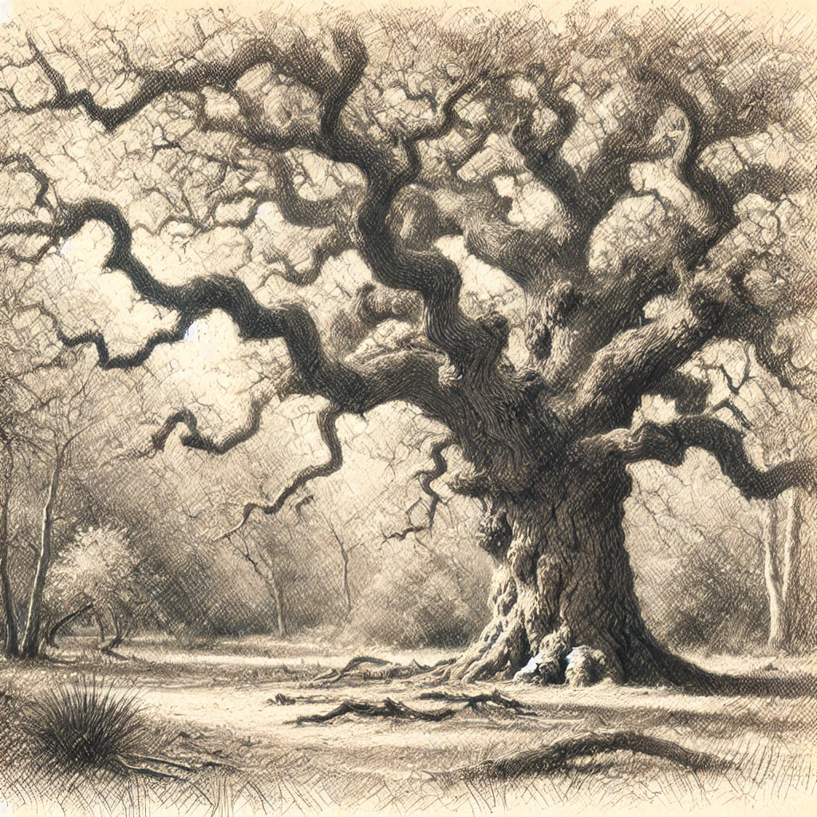
Example 3
Sketch of an old oak tree with gnarled branches in a quiet forest clearing. The scene is rendered in soft, pastel shades, reminiscent of impressionist art. The texture of the tree bark and the serene atmosphere are the primary focus.
Notes:
Example 3 Prompt:
"Sketch of an old oak tree with gnarled branches in a quiet forest clearing. The scene is rendered in soft, pastel shades, reminiscent of impressionist art. The texture of the tree bark and the serene atmosphere are the primary focus."

Slide 29

Ethical Considerations for Using LLM’s
Academic Integrity
Content Creation
Authenticity
Notes:
Academic Integrity: When using Large Language Models (LLMs) in an educational context, it's important to maintain academic integrity. This means using the tool to aid understanding and creativity, not to cheat or misrepresent one’s own work. For example, students should use LLMs to explore ideas or generate drafts but should not submit AI-generated content as their own original assignments.
Content Creation: LLMs can be powerful tools for creating content, but they come with responsibilities. Users must be aware of the potential for generating fake or misleading information. For instance, producing text that presents false facts or scenarios can spread misinformation. It’s crucial to use LLMs responsibly and ensure that any content created is clearly labeled as AI-generated when necessary.
Authenticity: It’s important to use LLMs in a way that respects authenticity. Passing off AI-generated text as one’s own work is not only unethical but can also damage credibility. When using LLMs for projects, presentations, or any form of public display, always give proper credit to the AI’s role in the creation process. This transparency helps maintain trust and integrity in your work.
You will review Ethics over the next two weeks in greater detail.

